Slide 1
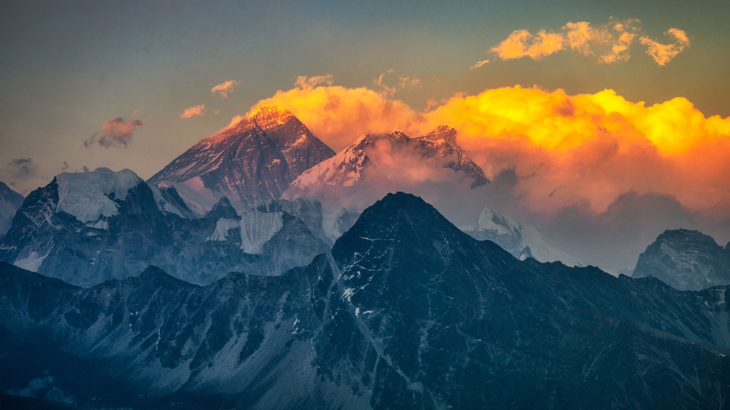
Medical Arabic Packet
Spring 2020

Slide 2
Upcoming Dates
February 28th- Donations Day STU 263
March 17th-Pre-Brigade Meeting-required
April 14th- Pre-Brigade Meeting-required
April 18th UNC Charlotte Global Brigades Conference
Register:
https://www.globalbrigades.org/2020-unccharlotte-slc/
https://www.eventbrite.com/e/global-brigades-regional-student-leadership-conference-tickets-84902089435?discount=UNCGBMember

Slide 3
Remaining Payments
March 16th- Seventh Installment of $275:
April 13th- Eight Installment of $275
May 11th- 9th installment $275:
June 8th- 10th installment $275
July 6- 11th installment $275

Slide 4
Common Greeting and Questions
Common Greetings and Questions
Hello | Ahlan Wa Sahlan
Good morning, Good afternoon, Good night | Sabah El Kheir, Masa’ el Kheir, Tesbah ala Kheir
Welcome | Afwan
My name is | Ismi ….
What is your name? | Ma Ismuka?
What is your child’s name? | Ma ism waladak (boy) Ma ism bentak (your girl)
Can you repeat your name please | Momken ismak mara tany?
I don’t speak Arabic Well. Can you please speak slowly? | Ana la atakalm al arabya gaydan, momken tatakalam sheway shewaya
How old are you? | Kam omrak?

Slide 5
Basic Commands
Basic Commands
Sit here, please | Ejlis hona, min fadlik
Stay here, please | Ebqa hona, min fadlik
Form a line, please | Qifu fi saf, min fadlik
Wait here, please | Entazer hona, min fadlik
Repeat that, please | Mara tany, min fadlik
Come with me please | Taala ma’y, min fadlik

Slide 6
Background Information and Vitals
English | Arabic
Does anyone in your family have a history of blood pressure, diabetes, or any other chronic disease? | Hal fu ostratak ay shakhs aindahu daght dam, sukar, au ay marad muzmen akhar?
Are you allergic to any type of medication? | Hal aindak hasasya min ay dawaa?
Can I weigh you | Momken awzenak?
Can I take your height? | Momken aqis tulak?
I am going to take your temperature | Sa akiis daraget Hararatik?
I am going to take your blood pressure | Sa akiis daght al dam
Can I take your pulse? | Momken aqis nabdak?
Are you currently breastfeeding? | Hal inti turadeen?
Is it possible that you are pregnant? | Hal inti hamel?
What are your symptoms? | Ma heya al aarad alti andik?
Why are you here today | Limatha anta hona al yaoum?
What do you have? | Min matha tashtaki?

Slide 7
More Vitals
English | Arabic | English | Arabic
Blood pressure | Daght al dam | Weight | Wazin
I am going to take your blood pressure | Akis daght al dam | I need to weigh you | Uriid an awzinak
Roll up your sleeve please | Irfaa kom al qamis | Please take your shoes off | Momken takhlaa hizaak
Relax your arm | Arih ziraaak | Stand on the scale | Qif ala al mizan
Your pressure is high/low/good/normal | Taghtak aali/ munkhafid/gayid/ aadi | Temperature | Harara
Pulse | Nabd | I am going to take your temperature | Akis hararatika
I need to take your pulse | Akis nabdak | Open your mouth | Iftaah famak
Give me your wrist | Adini miaasamak | Put the thermometer under your tongue and leave it there | Daa al termomtr that lisanak wa itrukuhu

Slide 8
Common Responses and Verbs
I can’t | La astateea
I can’t stop | La astateea al tawaquf
I have problems with | Aindi mashakel maa
It hurts to | Yu’limuni
I feel I can’t | Ashur ani la astateea
My (body part ) | ….. yu’limuni
I have a cramp | Andi tashanug adali
I have an itch | Andi harsh

Slide 9
Important Verbs
To walk | yamshi | To open | yaftah
To eat | Ya’kul | To close | yaghlak
To sneeze | yaatas | To bend | yuthni
To chew | yamdugh | To lift | yahmil
To break | yaksar | To move | yuharik
To urinate | yatabawal | To hear | ysmaa
To cough | yakuh | To breath | yatanafas
To see | yaraa | To fall | yaqaa

Slide 10
Basic Anatomy
English | Arabic | English | Arabic
Mouth | Fam | hips | Al fakhzain
Neck | Raqaba | back | Al zahr
Bottom | Mua’khera | Molar | dars
Wrist | miaasam | Nose | anf
Ear | Ozon | Ear | ozon
Chest | Sadr | Leg | regl
abdomen | jsm | Ankle | kahel
arm | zeraa | Arm pit | Bat/ibet
waist | khasr | head | Ra’as
Tooth | asnaan | elbow | Kuu / mirfaq
Shoulder | Katif | fingers | asaabia
thigh | fakhz | hand | yad
pelvis | haoud | Belly button | sura
stomach | maaida | heel | kaab

Slide 11
In the Pharmacy
dropper | qatara
drops | nukat
teaspoon | Milaqa saghira
tablespoon | Milaqa kabira
pill | haba
syrup | sharab
ointment | marham
Take one table once a day | Haba wahida fii al youm
Take one tablet twice a day | Haba wahida maratein fii al youm
Take two tablets | Habatein fii al youm
A day | Fi al youm
A week | Fi al asbuua
Take one tablet every 6 hours with food | Haba wahida kol sit saaat maa al taam
Can I help you | Ay musaada?
Cut the tablet in half | Aqtaa al haba nesfaien

Slide 12
Common Medical Conditions / Medications
Antibiotic | Antibiotic | Diabetes | Sukar
Asprin | Aspriin | Asthma | Asma
Dose | Guraa | Scabies | Garab
Insulin | Insuleen | Parasites | Tufaylyat
Sickness / dizziness | Dawar | Heart disease | Marad qalb
Nausea | Ghamaman | Pain | Alam
Sickness | Marad | Cough | Koha
Infection | Eltihaab | Fever | Homa

